Slide 1
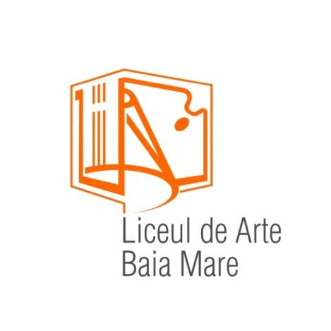
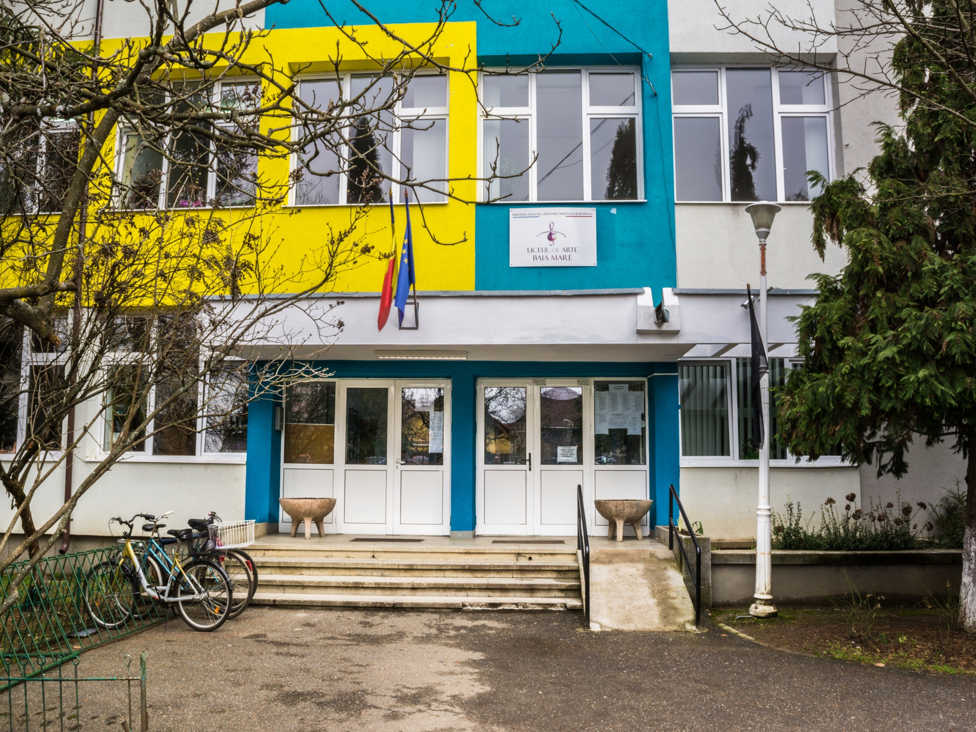


THE ART HIGH SCHOOL

Slide 2
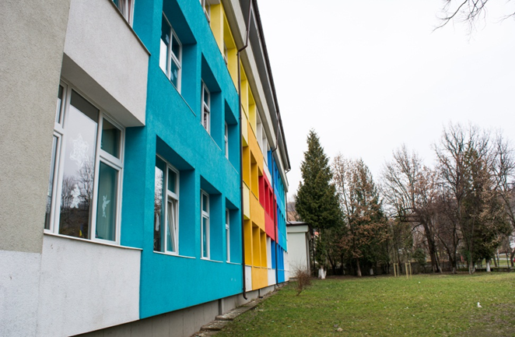
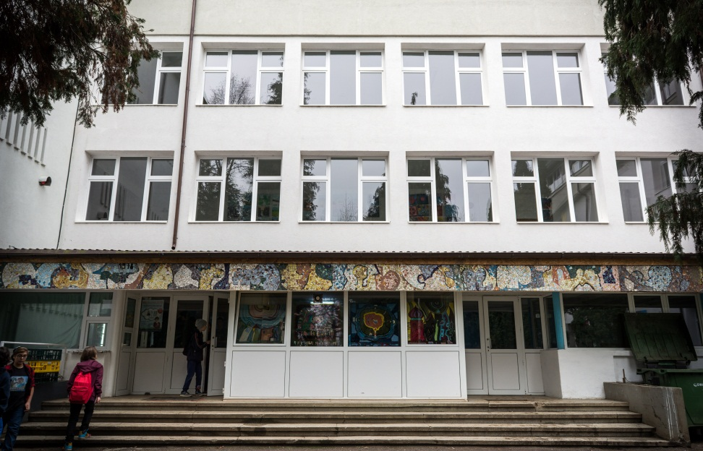
The Art High School from Baia Mare lies in a beautiful mountain area from the north of Romania, a place where traditions have always had an important role in the community life. It was founded in September 1958 under the name of "The School of Music and Fine Arts", later becoming "The Art High School" due to its outstanding results.

Slide 3
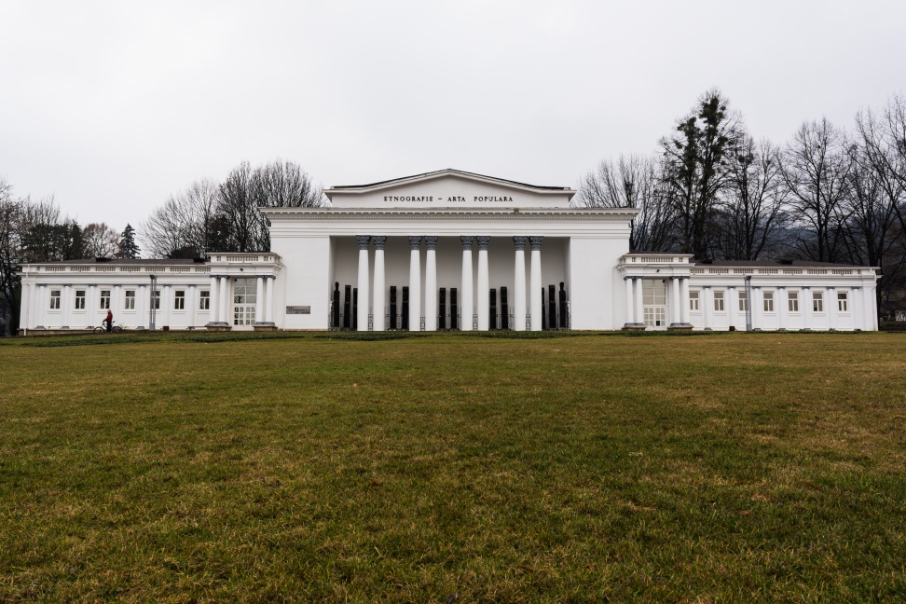
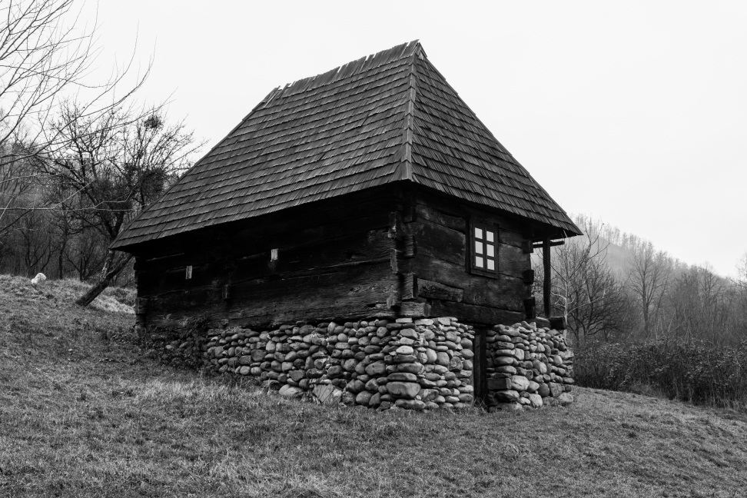
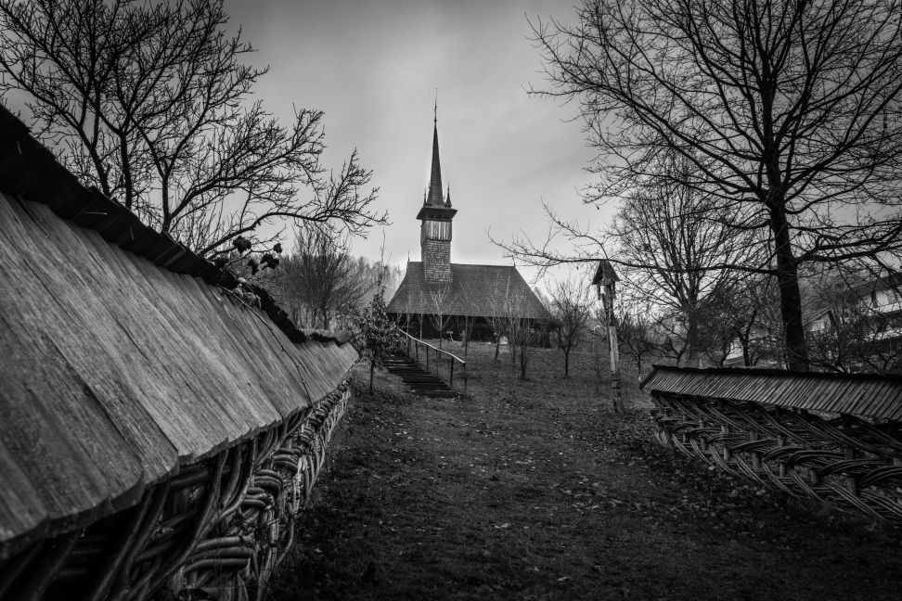
Placed in a natural beautiful environment, the Arts High School is surrounded by “Regina Maria” Park, the village Museum and the Ethnographic Museum.

Slide 4
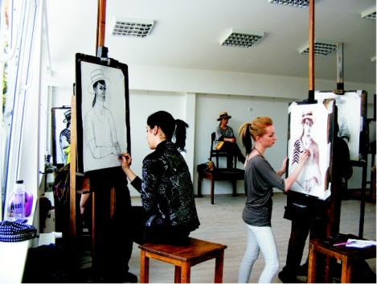
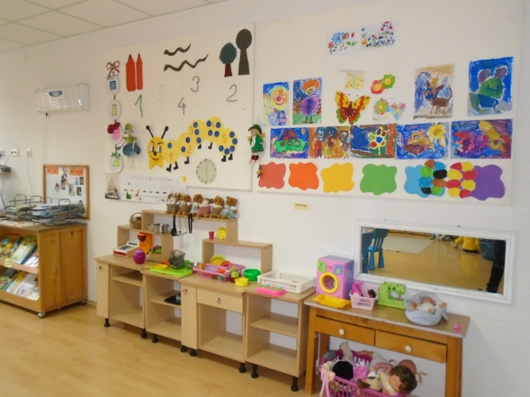
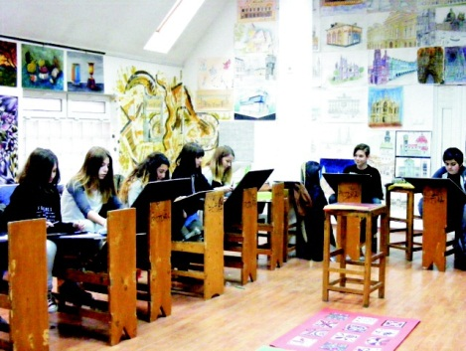
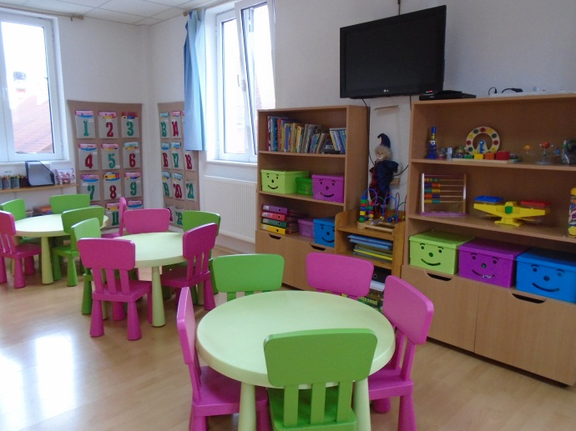
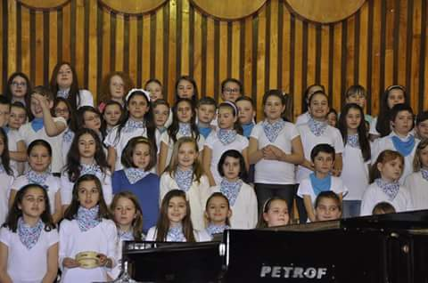
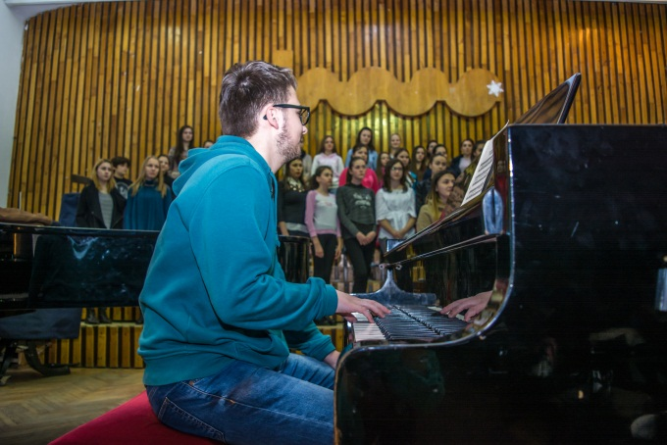
At present, our institution inhabits about 900 students from all academic levels: kindergarten, primary, secondary and high school, and almost 150 teachers of various subjects: music, fine arts, architecture, languages, history, geography, chemistry, physics, etc.

Slide 5
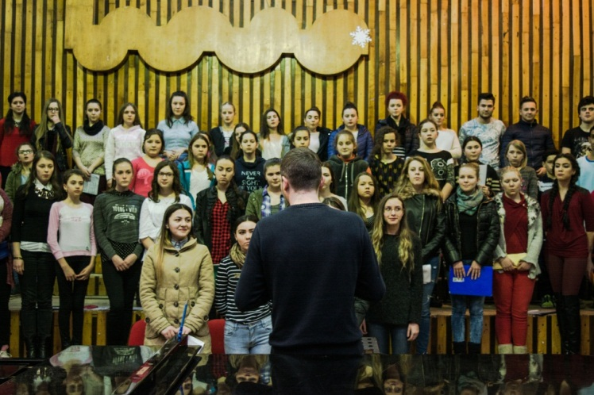
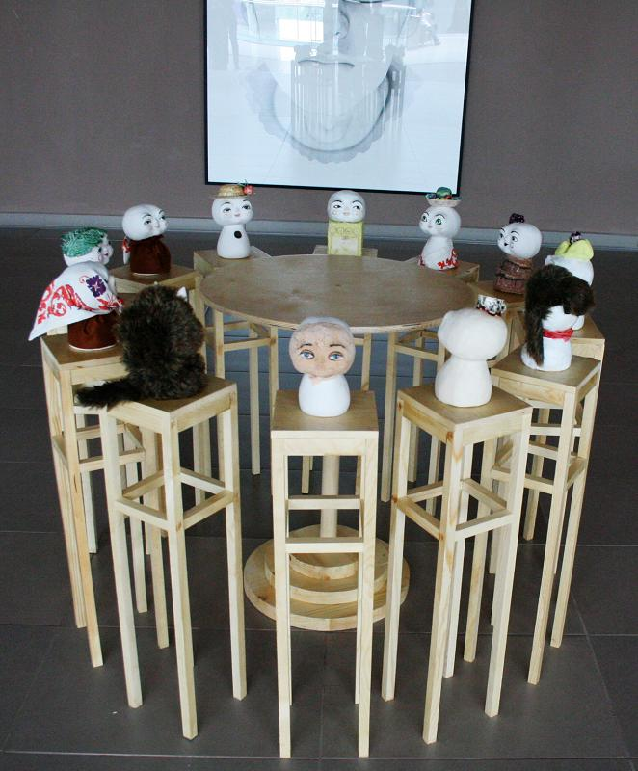
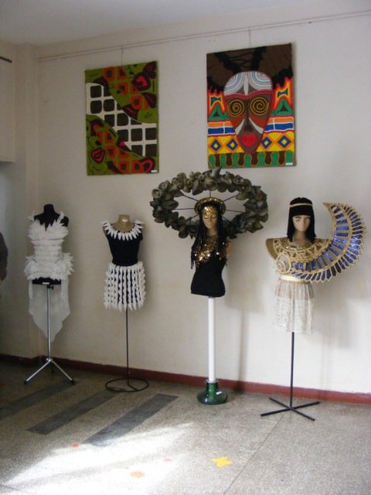
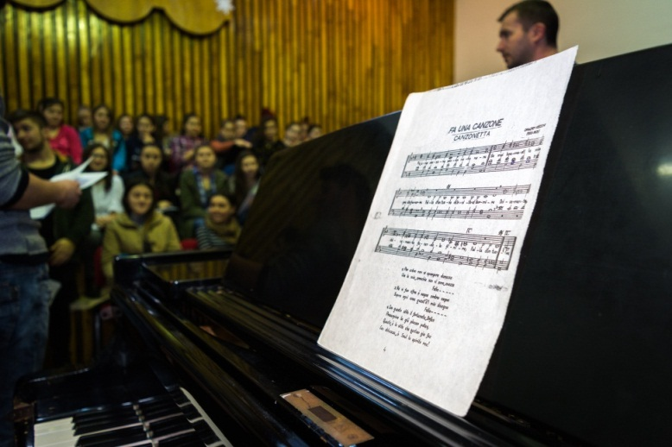
Closely guided by their teachers, our students get on stage on various occasions to present their accomplishments in front of parents, relatives, other teachers, students and official figures. Every holiday, event or important moment is marked by musical auditions, choral and orchestral performances, recitals and art and design exhibitions.

Slide 6
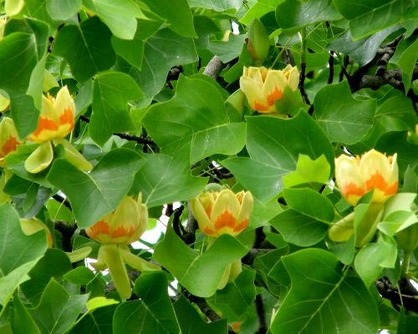
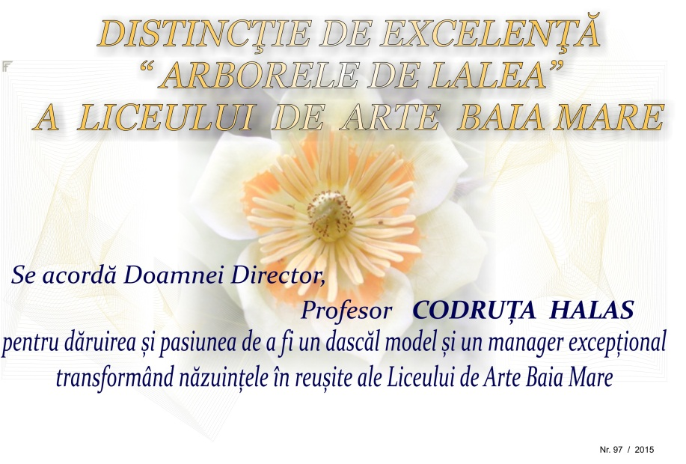
For several years now, we have initiated a teachers-parents partnership to keep parents closer to the school’s life and needs, to make them partners in the educational development of their children. On this occasion, parents are invited to a concert and a dinner party in a fancy restaurant in town, and all teachers and parents socialize and get to know each other in a more relaxed atmosphere. This event is known among parents and students alike as the school’s festival and it overlaps the blooming of a very rare and protected tree that we are happy to have in our schoolyard – the Tulip Tree. We have designed and created the Tulip Tree Award that we offer to students who received prices in the Fine Arts, Architecture and Musical National Olympics that same years, as well as to teachers with great accomplishments.

Slide 7
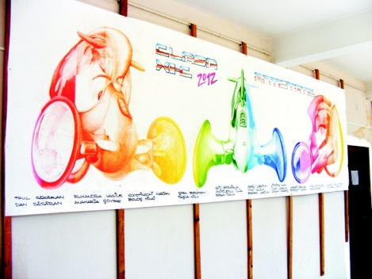
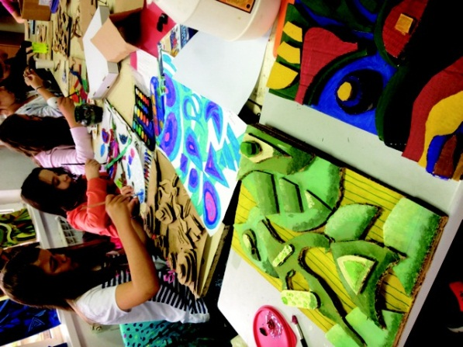
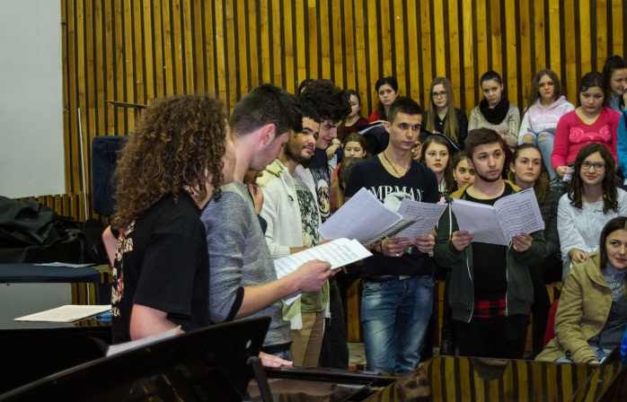
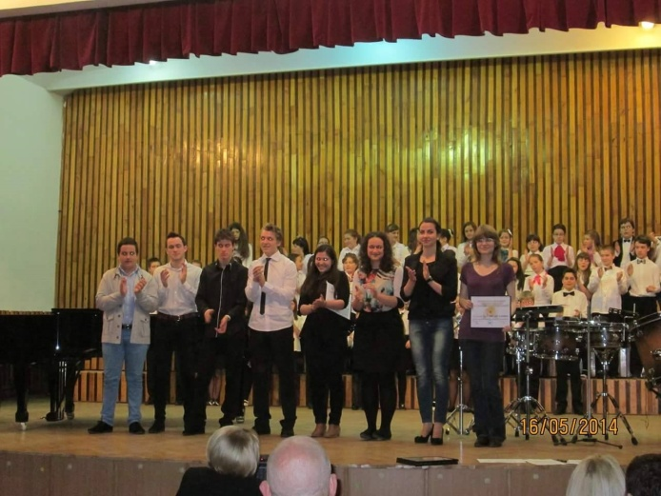
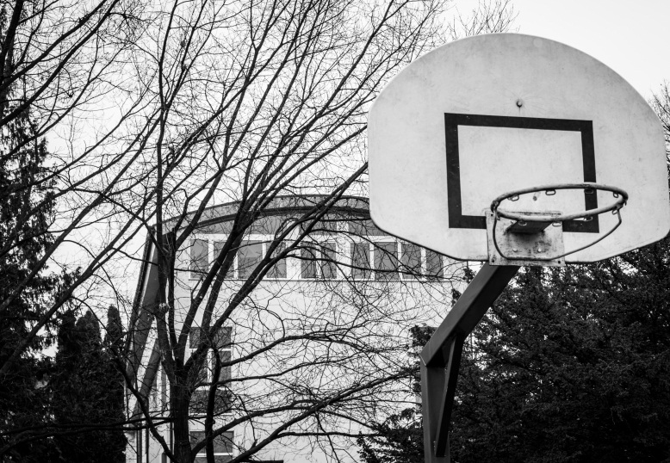
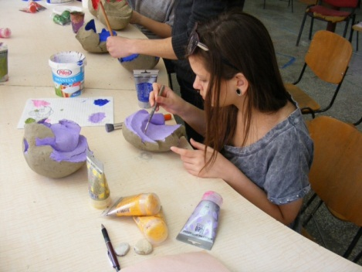
Due to this wide span of activities, our institution has a great impact on the local community, on the young people coming from various social environments, on the elderly people from the social institutions as well as on the senior citizens, by offering them free access to culture regardless of their ethnic or social background and, thus, facilitating a better social integration through music and art.

Slide 8
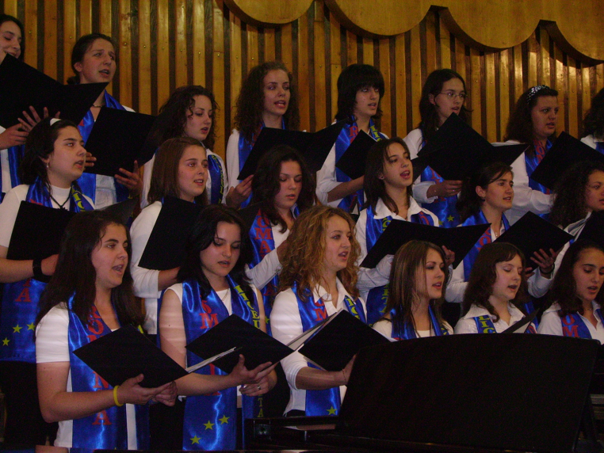
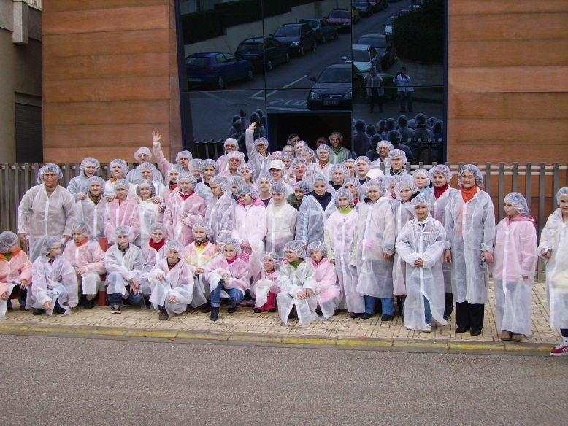
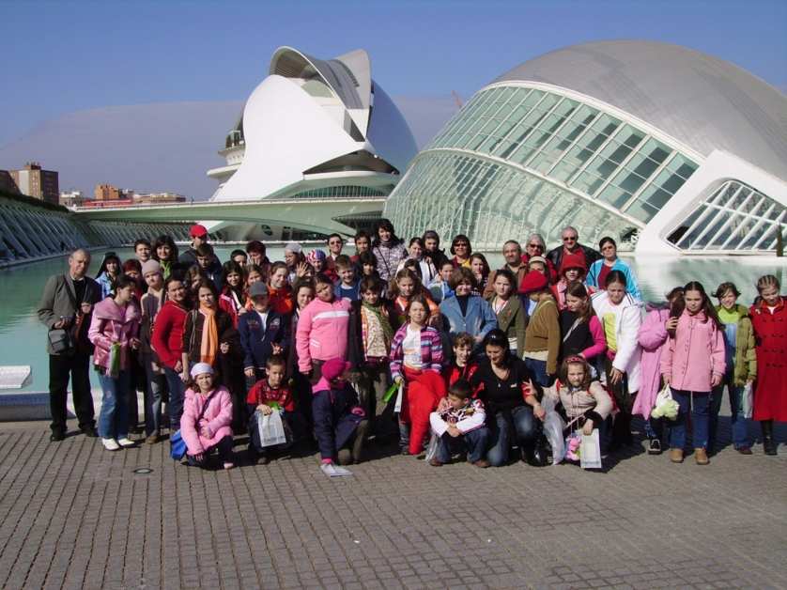
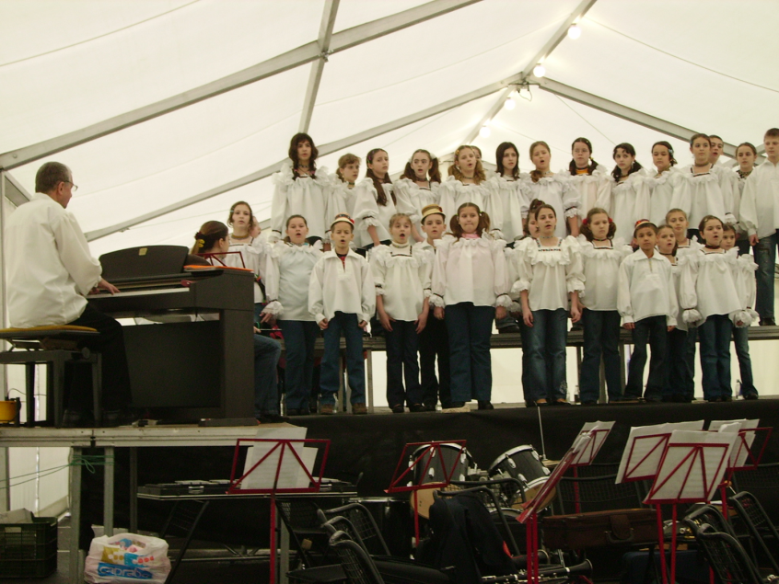
Projects and partnerships
PARTAGES ET ECHANGES INTERCULTURELS POUR L’INSERTION PAR LA CULTURE, LA MUSIQUE ET LE CHANT CHORAL ( 2005-2006)
GRUNDTVIG PROJECT 2 SUBSIDIZED BY THE EUROPEAN COMISSION

Slide 9


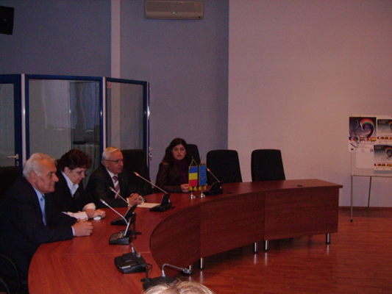
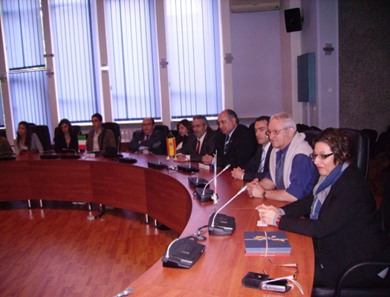
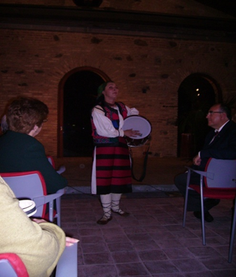
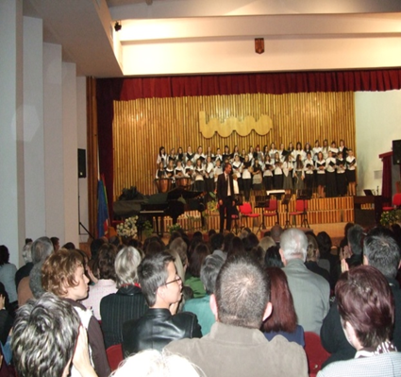
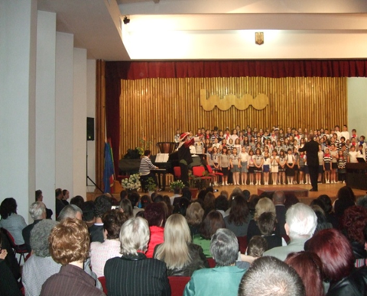
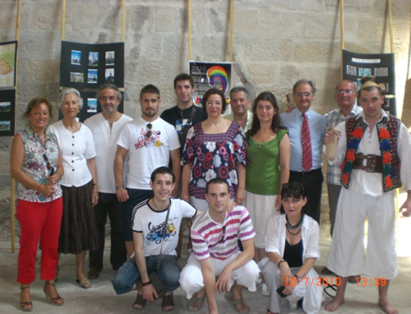
ANIM’ART EUROPE (2009-2011)
PROIECT GRUNDTVIG
SUBSIDIZED BY THE EUROPEAN COMISSION

Slide 10


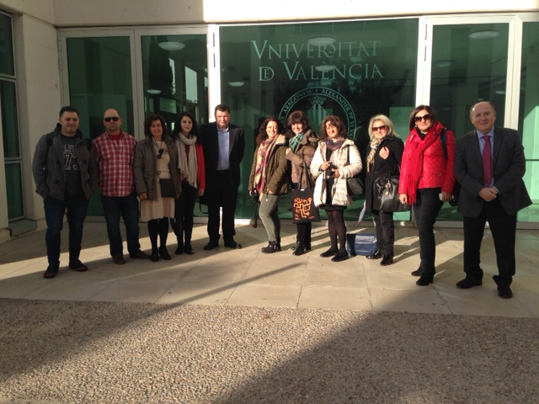
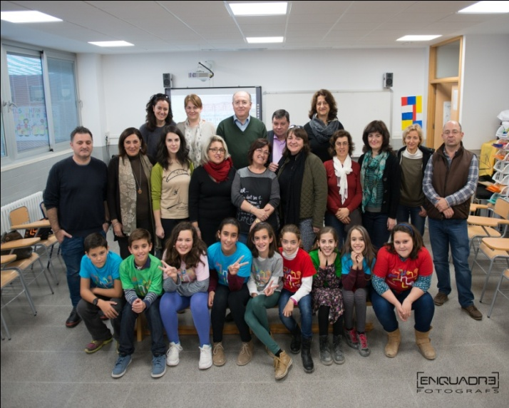
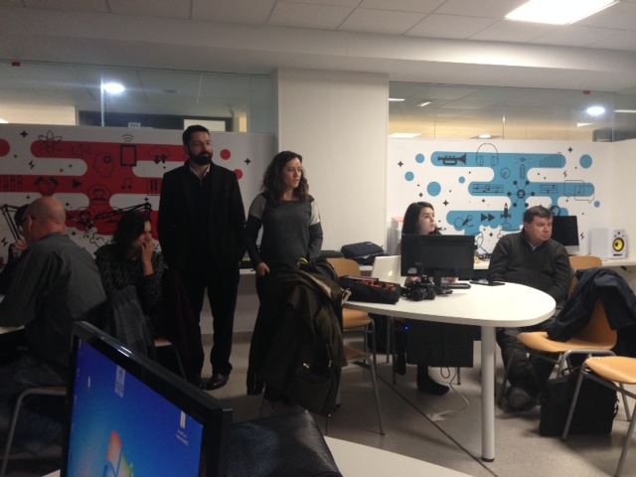
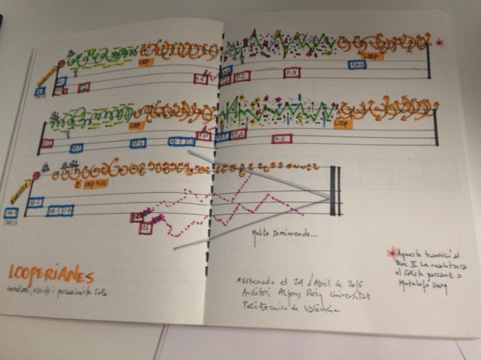
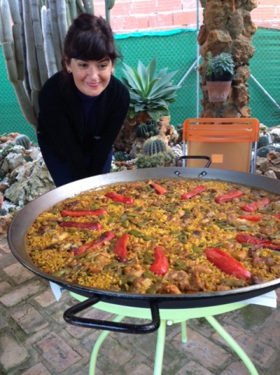
“TECHNOLOGY FOR LEARNING AND CREATIVITY: WEAVING EUROPEAN NETWORKS THROUGH COLLABORATIVE MUSIC CREATION” (2015-2017)
ERASMUS+ KA201 PROJECT SUBSIDIZED BY THE EUROPEAN COMMISSION

Slide 11

Address:
Petofi Sandor Street, no. 2-4, Baia Mare,
zip code – 430165, Maramures, Romania
web: www.artabm.ro
email: artabm@yahoo.com
phone: 004-0262-275.482
004-0262-276.226
004-0362-802.442
mobile: 004-0724-267.255
fax: 004-0262-219.590
Slide Show: prof. Lavinia Jurge, prof. Sorina Mihut, prof. Monica Boier,
prof. Cristina Roman, Eduard Bereczki
Soundtrack: Sonata for Piano and Violin no. 3 in A minor
(popular Romanian style), op. 25, by George Enescu
- 2016 -

